Slide 1

BFX-AT100 LED issue 8D report
FOXCONN CPEG JBD_VN
Jul-29-2021
Version 13

Slide 2
D1. Establish the Team
Team Leader
Team Member
PM: Ben Zheng, Lam Zhou
PD: Ruan Wen Yong
QA: Rachel Nguyen, Robert Wu
SQE: Chun Ke
IE: Hai Ly
Foxconn
  MFG Manager : David Yin
  QA Manager : Charlie Su/ CB Lin

Slide 3
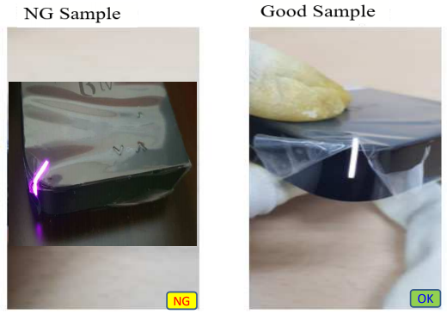
D2. Description of Problems
Issue Description
Feb-2021, ALT customer complain LED ( Yellow & Purple ) issue on RMA center:
20-Fed-2021, Everlight received from Fii 7 pcs LED issue ( Yellow & Purple) for analysis root cause and Fii retained 1 pc for analysis.

Slide 4
D2. Description of Problems
Issue Description
20-Fed-2021, Everlight received from Fii 7 pcs LED issue. The detailed information is as bellow :
RMA send LED defect q'ty : 636 pcs ( Att file )
Total deployed unit q'ty :830,000 -[2019.06~2021.03]
Type | SN | Production_Time | Vendor(Everlight) Lot Code | Vendor(Everlight) Date Code
Yellow | 2149688001201904040599 | 09/18/2019 15:50:01 | Y190730S1002DF | 190730
 | 2149688001201904024318 | 09/16/2019 05:40:20 | Y190730S1002DF | 190730
 | 2149688001201904032610 | 09/15/2019 16:02:53 | Y190730S1002DF | 190730
 | 2149688001201904017454 | 09/12/2019 08:20:13 | Y190730S1002DF | 190730
Purple | 2149688001201909023362 | 11/06/2019 16:21:41 | Y190914G1001DDFWX35 | 190914
 | 2149688001201908031823 | 10/12/2019 16:14:21 | LY190817S1002DDFWX35 | D190817
 | 2149688001201904035168 | 09/17/2019 03:01:02 | Y190730S1002DF | 190730
 | 2149688001201904041675 | 09/19/2019 03:15:47 | Y190730S1002DF | 190730
Checking technique: 8 Units no have rework or repair data, all doing follow normal process .

Slide 5

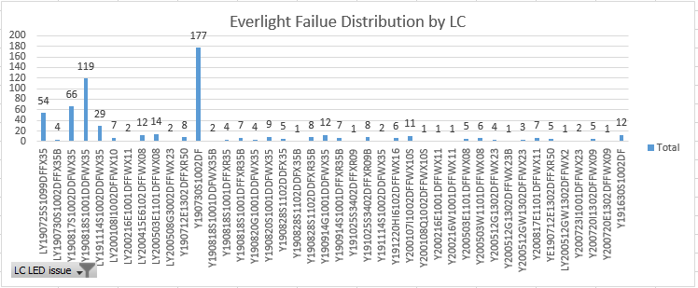
D3. Containment
Check 636 units ALT inform LED Fail issue.
Check record Everlight material DC & LC of 636 pcs Customer defect LED issue as bellow:
Result : LED fail with DC190730 ( 30%) & DC190818 (21% ), and LC LY190818S1001DDFWX35 ( 20%) & Y190730S1002DF (30%). LED fail issue concentrate DC& LC 2019-July & 2019-Aug.

Slide 6

D3. Containment
Check Fii received Everlight material and 636 units DC failure distribution as bellow:
Result : Concentrate LED fail with DC& LC 2019-July & 2019-Aug is abnormal.

Slide 7
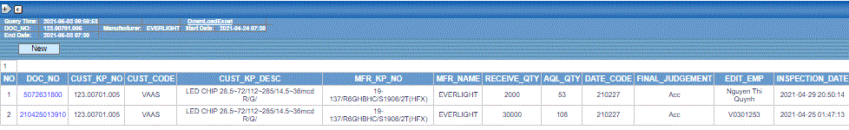
D3. Containment – Check Inventory status.
3.1 Check all LED Material in Warehouse with 123.00701.005 .
29-Apr-2021, Fii factory hold 32K material incoming on RMB stock – 123.00701.005 DC 210227. Waiting return
Everlight vendor for rework LED issue. And Everlight change new 32K Using strict small current value to the G/B chip
test in order to control leakage current. ( Improved spec from 10uA, 1.8~2.4V to 1uA, 2.0~2.4V )
SQE_Chun Ke 29-Apr Done.
Result : Check inventory have 32K material 123.00701.005 LED material incoming, Hold on MRB station. Everlight vendor had changed 32K material improved LED issue , Fii received new material on 6-May-2021.

Slide 8
D3. Containment – Check Inventory status.
3.2 Fii will receive RMA LED issue .
BFX-AT100 LED issue – Fii will follow RMA process, repair LED issue - Total 636 pcs.
PM_ Nelly May-2021 On going.

Slide 9
D4. Root Cause ( Fii escapes LED issue)
Check Fii escapes LED issue :
1. ALT product LED change abnormal color issue have cover 100% by function test online production , before
production shipping to ALT customer.
2. Escapes LED light abnormal ( Red / Yellow/ Purple ) cause material incoming. Because LED abnormal loss after real
using time by end customer.

Slide 10
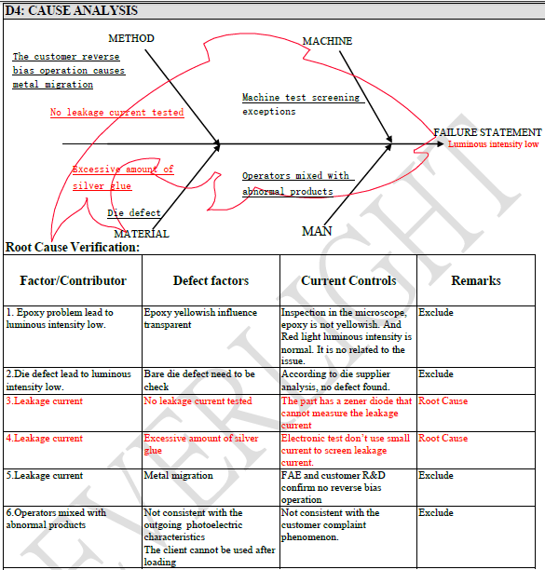

D4. Root Cause ( Everlight FA)

Slide 11
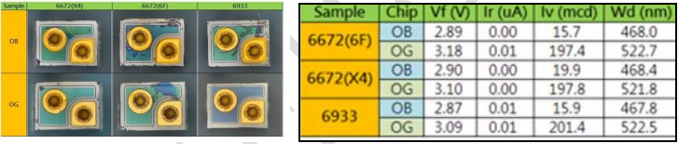
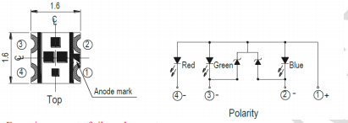
D4. Root Cause ( Analysis conclusion )
1. Epoxy problem lead to luminous intensity low: exclude
Inspection in the microscope, epoxy is not yellowish. And Red light luminous intensity is normal, only the G light and B light
abnormal. It is not consistent with the customer complaint phenomenon.
2.Die defect: exclude
Provide defective sample SMD 3 EA. For die supplier analysis.no defect was found.
After chemically de-cap the sample, OB/OG wafers were removed and the appearance was examined by microscope. Except for part of the residue, no obvious abnormality was found in the naked crystal appearance after disassembly, and no darker color was observed on the
electrode surface before disassembly.
After the bare crystal was tested by automatic testing machine, the voltage was within the normal specification range, and
there was no high leakage problem, so it was determined that there was no failure of the chip itself.
3. No leakage current tested: root cause The part has a zener diode that cannot measure the leakage current, so even the leakage
happen, no way to find out.

Slide 12
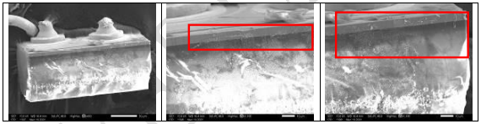
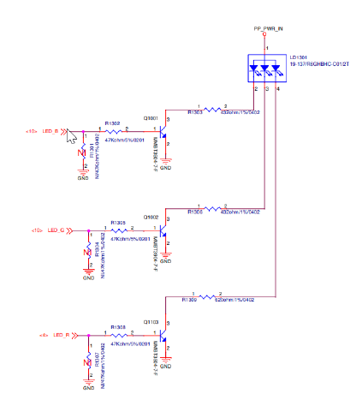
D4. Root Cause ( Analysis conclusion )
4. Excessive amount of silver glue: root cause Some material attachment on chip side (red mark), EDX(Energy-dispersive X-ray spectroscopy)
confirms that is silver element.
5. Metal migration: exclude Everlight_FAE and Foxconn discuss the design of the circuit. There is no reverse bias in the circuit, so metal
migration can’t be happen.

Slide 13
D4. Root Cause ( Analysis conclusion )
6.Operators mixed with abnormal products: exclude Not consistent with the outgoing photoelectric characteristics, client cannot be used
immediately.
Conclusion :
Problem Root Cause:
The possible reason is that the amount of sliver paste higher, and it close with the P/N Junction area causing a small leakage current condition.
Reason of screening failure : The product has an Zener diode. The leakage current of the chip end cannot be tested during the electrical test in the factory, resulting in such abnormal loss.

Slide 14
D5. Corrective Action ( Fii action)
5.1 Add Everlight OQC :
1. From 02/May/2021, SQE request Everlight provide OQC report add new LED function test item for each shipping
lots to Fii. (From the lots change new 32K Using strict small current value to the G/B chip test in order to control
leakage current. ( Improved spec from 10uA, 1.8~2.4V to 1uA, 2.0~2.4V )
SQE_Chun Ke 06-May-2021 Done.
2. From 06/May/2021, Fii used LED improved from Everlight Spec 1uA, tighten test criteria. DC 04/01.
( Everligh short team action )
SQE_Chun Ke 06-May-2021 Done
5.2 ALT reliability test final product
Fii provide 20 pcs final sample to ALT-RD for reliability test – user LED improved by Everlight. All cost charge for Evelight vendor.
SQE_Chun Ke 25-May-2021 Done
PM_Nelly Jun-2021

Slide 15
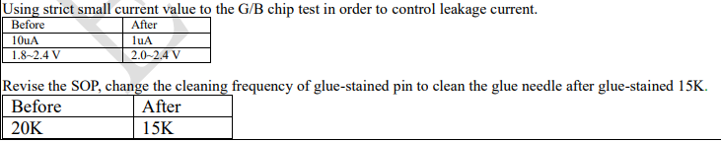
D5. Corrective Action To Root Cause ( Everlight vendor action)
5.1 Short-term approach:
5.2 Long-term approach:
Silver paste change to insulating paste,5/18 168hr rel test completed,5/20 report out; ECN procedure, modify it in BOM. R & D team evaluate the solution of changing the silver paste to insulating paste.
The schedule as follows:
Trial production order/material requisition-4/12 Done
Trial production was completed-4/21 Done
Provide trial production report-4/28 Done
Reliability Analysis Report-5/20 Done

Slide 16
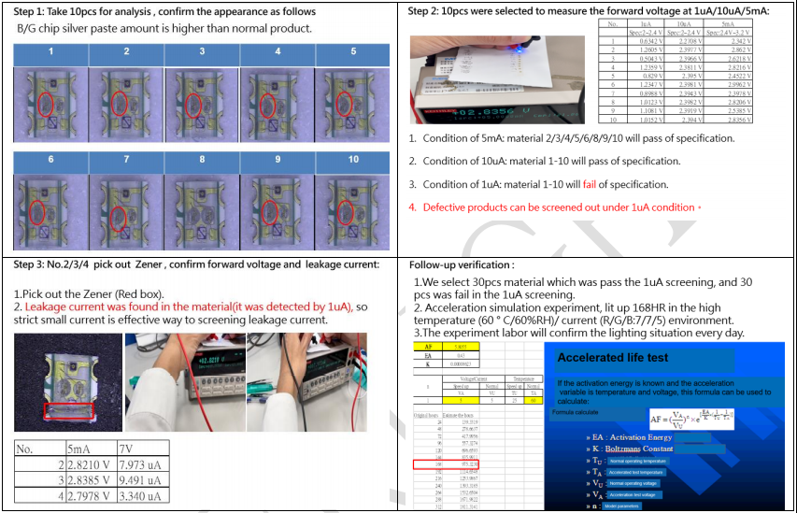
D6. Verification of effectiveness ( Everlight Verification )
Corrective Action To Root Cause: Verification of screening method using small current:
We made the silver paste amount higher on purpose for experiment. And using strict small current value for screening leakage current. After that, picking out the abnormal material’s Zener to measure whether there is leakage current in G/B chip. Indeed, the leakage current is found. The screening method is work.

Slide 17
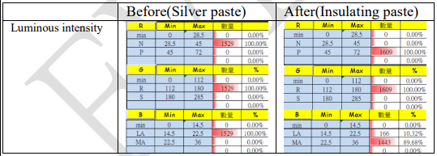
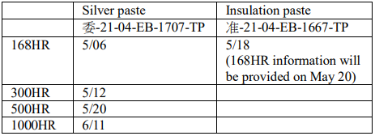
D6. Verification of effectiveness ( Everlight Verification )
Comparison of photoelectric property between silver paste and insulating paste material:
The changes can still meet the Customer specifications.
1.After silver paste is changed to insulating paste, only LED Luminous intensity is affected。
2.Luminous intensity is still up to spec。
Reliability time: According to past experience, the feasibility of material change can be estimated based on the light decline condition after 168HR test.

Slide 18
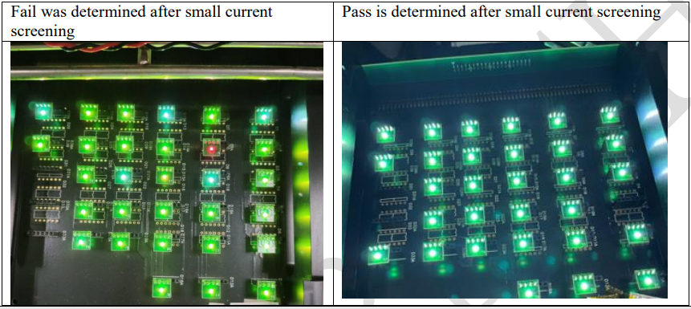
D6. Verification of effectiveness ( Everlight Verification )
Short-term : 1uA,tighten test criteria. 04/01 installed. ( Done )
Long-term : Silver paste change to insulating paste, 5/18 168hr rel test completed,5/20 report out; ( Done )
ECN procedure, modify it in BOM on 5/27. ( On Going )
Small current screening fail material 500HR(5/20) confirmation:
After 168HR of small-current screening, the Fail material appears the same abnormal condition as the customer。
The customer abnormal color shift can occur again。
The control group still had no discoloration at 500HR

Slide 19
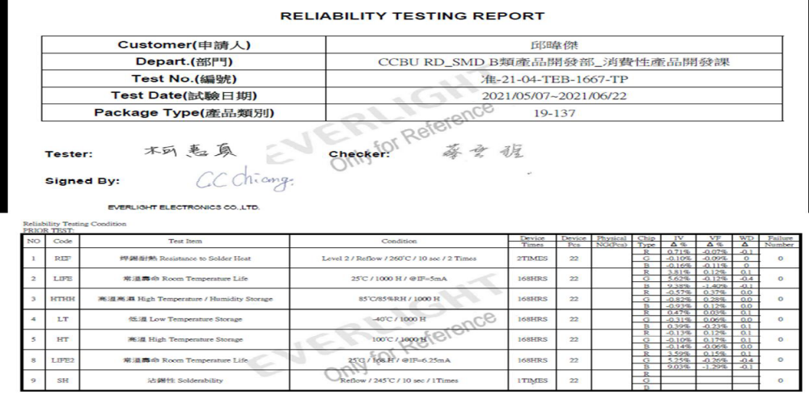
D6. Verification of effectiveness ( Everlight Verification )
Reliability Testing Report 168hr rel test completed,5/20 report out; ( Done )

Slide 20
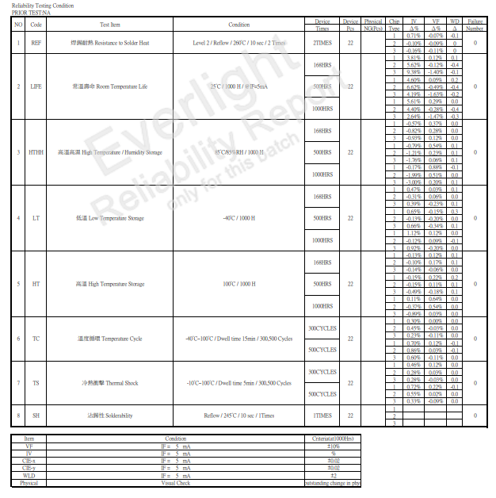
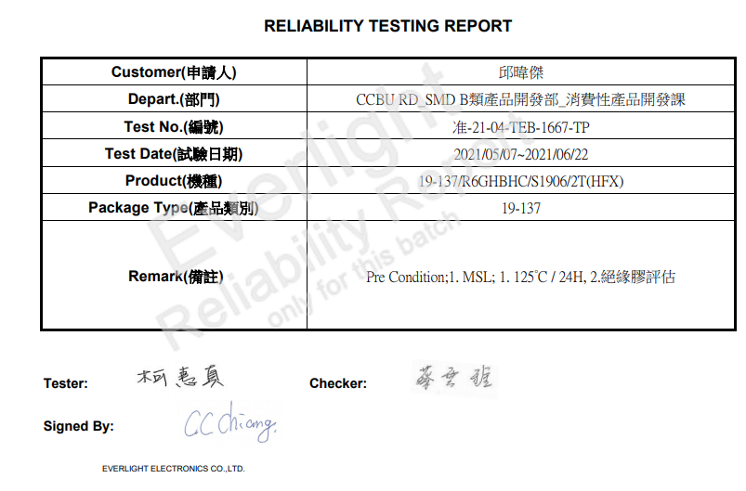
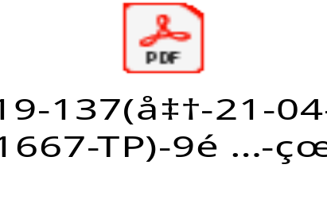
D6. Verification of effectiveness ( Everlight Verification )
Reliability Testing Report 1000 hours reliability test completed,6/11 report out; ( Done )

Slide 21





D6. Verification of effectiveness ( Fii verification )
Quality alert and SOP were already updated inspection requirement and hang on production line, IPQC keep audit and verifying the implementation on production line.
SOP check LED on Test Function
FT1 Test Station | FT Test Station | RC Test Station | OBA Test Station | Quality Alert

Slide 22
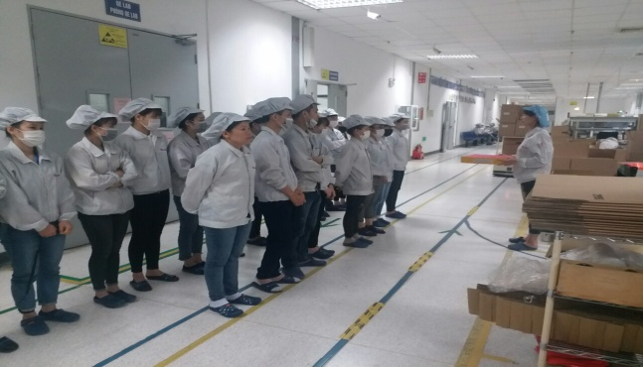
D7. Prevent recurrence
Line leader remind all operators before production and monitor their operating daily.
IPQC will random sample check all test station and OBA station follow AQL .
Owner: PD/PQE: Huu Loi, Luu Mien

